Slide 1

Phone addiction

Slide 2
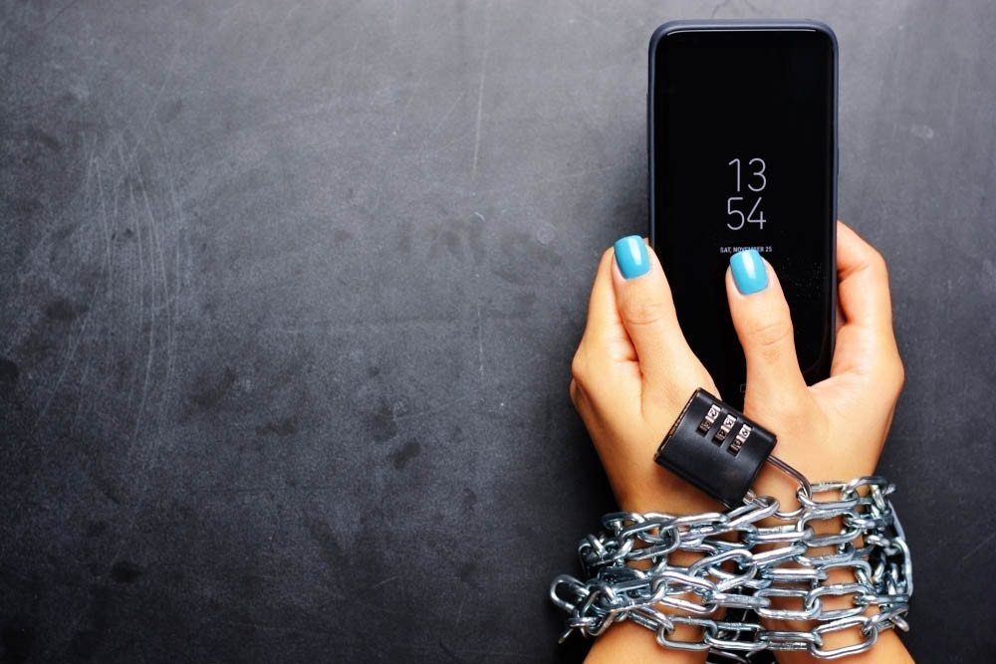
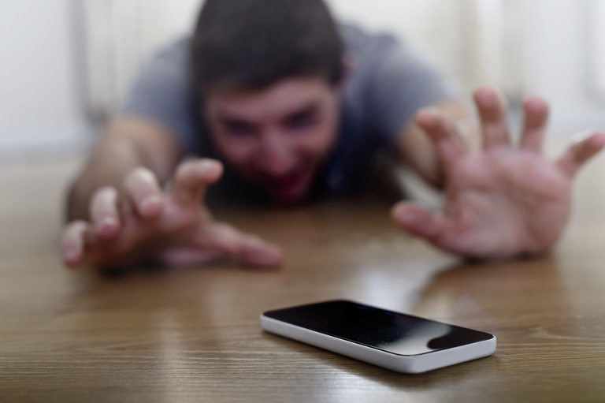
Smartphones are undoubtedly useful technological advances, but their use can affect work, school and relationships. When we spend more time online than interacting with people around us, when we can't stop checking our phone for new messages and emails - even when it has negative consequences in your life - it may be time to reconsider using your device.

Slide 3
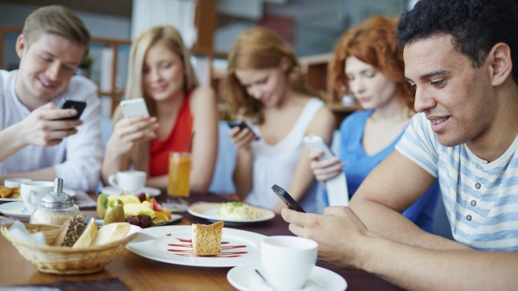
Like drugs and alcohol, the Internet can trigger the release of dopamine in the brain (the neurotransmitter responsible for the sensation of pleasure in the human brain). But dopamine is also a hormone of addiction and dependence, because all substances, people and activities, everything that causes our pleasure, can lead to addiction and dependence. Addiction to social networks, dating apps, text messaging can reach the point where virtual friends become more important than real relationships. We've all seen couples sitting together in a restaurant, ignoring each other and staring at their phones.

Slide 4
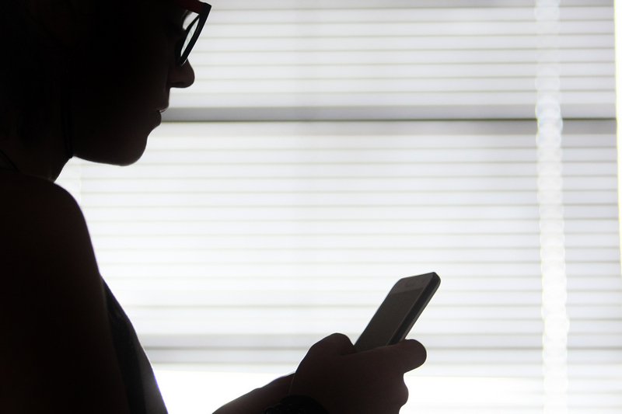
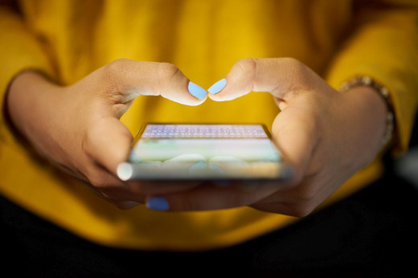
Also, excessive use of a smartphone disrupts sleep, which has a serious impact on our overall mental health and memory. After all that has been said so far, we can summarize that the telephone, on the one hand, is a necessary means of doing work and talking, but on the other hand, it can be a "weapon" in the hands of the wrong person. Personally, I could not imagine life without a mobile phone, but I realize that at some point this may play a bad joke on me.

Slide 5
Thanks for your attention!
Prepared by: Tony Todorov

